Slide 2
The EDiS Idea
Who We Are
professionals from 10 European distributors of industrial supplies
a team of open minded experts
qualified and aware of how important it is to keep up with changes and requirements of markets
What We Aim For
to know each market and to interprete their specific requirements
to anticipate the customers‘ needs thanks to the exchange of partners and updating of products reached through continuous monitoring, made by its members

Slide 3
Our Products
A large variety of supplies defined by quality and competitive prices
The EDiS products are a safe investment due to continuous research of the best supply sources
technical articles
hoses and couplings
rubber and plastic materials
safety products

Slide 4
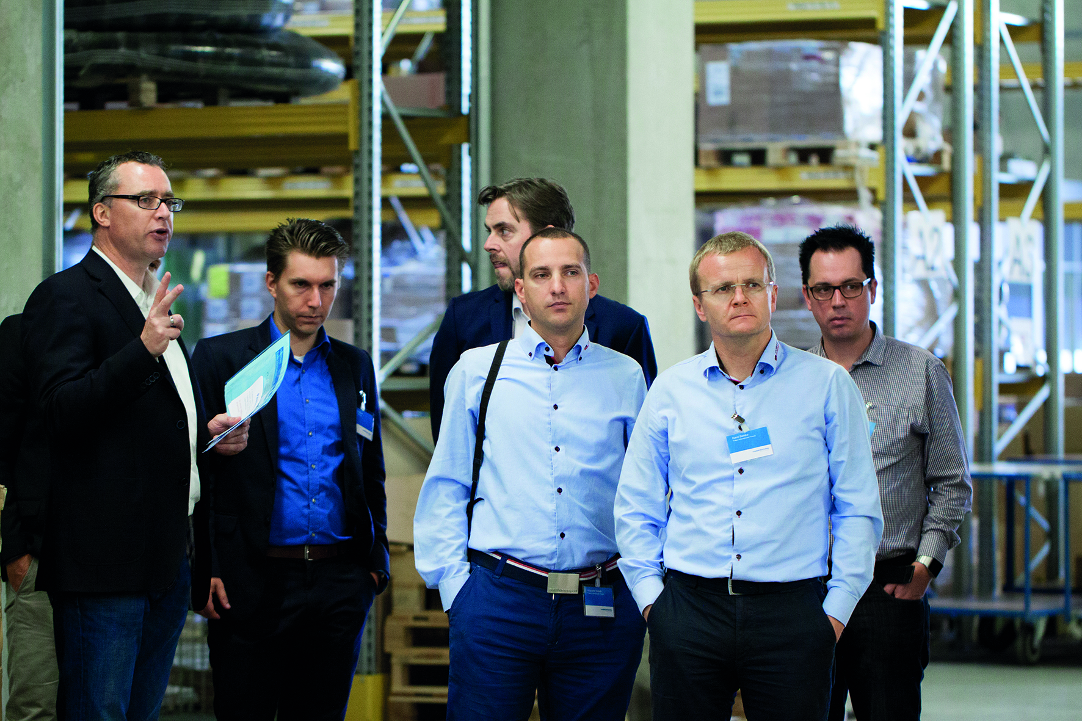
EDiS Organization
Management Board
regular exchange between management representatives
YEF
young executives forum for individual development
5 expert groups for intense networking:
industrial hoses
metal hoses
hydraulic hoses
rubber sheetings
PPE

Slide 5
EDiS Members

